Slide 1
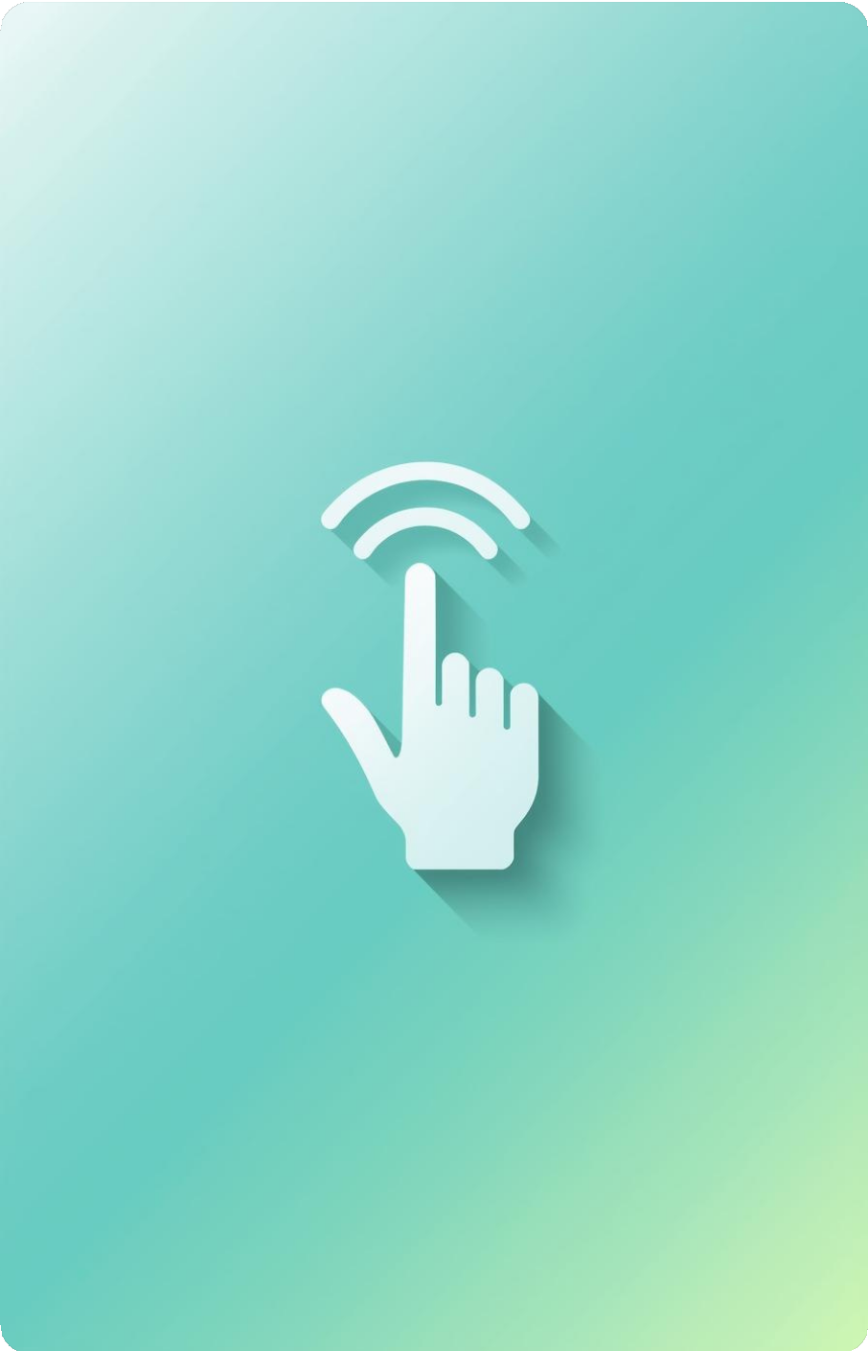

Wearable Hand Gesture Recognition for Laptop Control
Group -6
2310030157-N.Karthikeya 2310030115-A.Lokesh
2310030045-T.Sai Uday
2310030046-S.Nikhil 2310030308-V.Karthik
Guide: Dr.Shadab Siddiqi and Dr.UmaRani

Slide 2
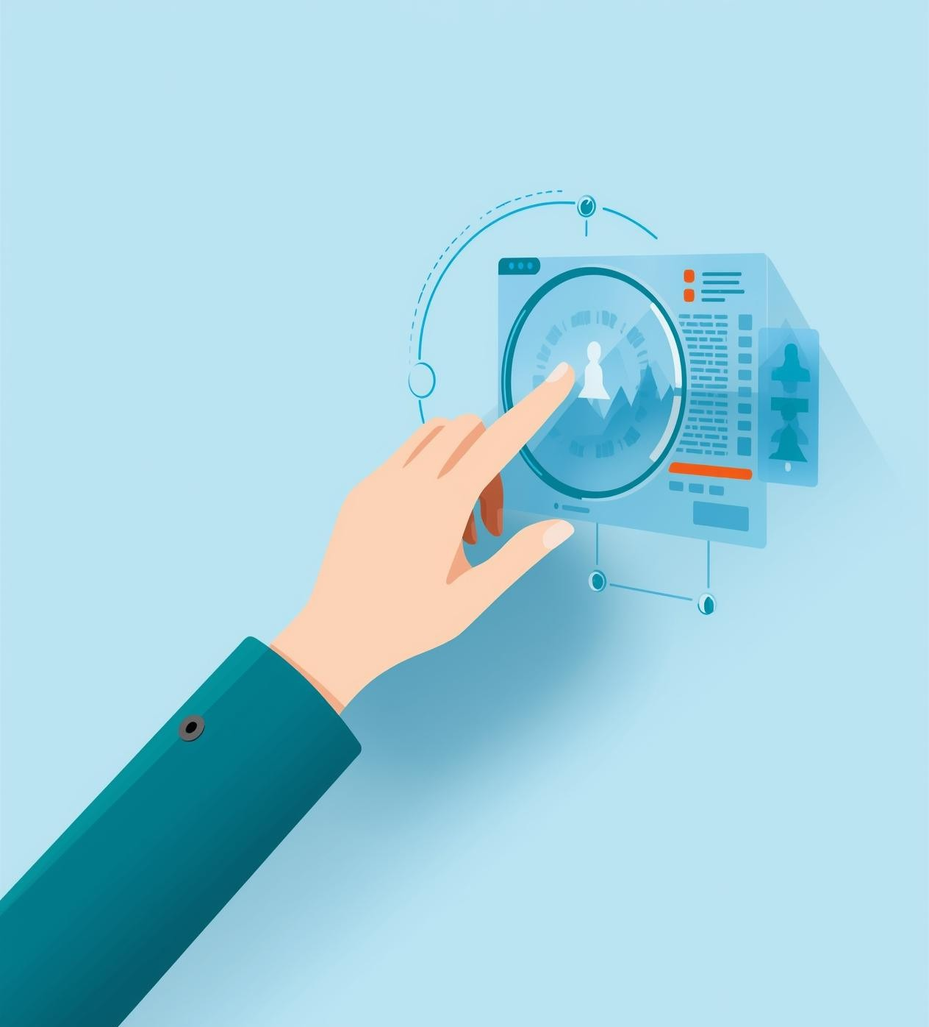
Addressing Inaccessible Input Devices
Traditional input devices can often be challenging or inconvenient for users, especially during presentations or for those with physical disabilities,
highlighting the growing need for more natural interaction methods.

Slide 3
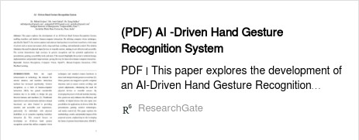
Our Solution
Wearable Hand Gesture Recognition for Laptop Control
Key Features
Wearable Gesture Input Module: Combines ESP32 with an IMU Real-time Motion Capture: Utilizes accelerometer-gyroscope fusion
BLE-based Transmission: Ensures low-latency gesture communication Python-driven Host-Side Processing: Implements a gesture processing engine
Action Mapping Layer: Facilitates laptop control for mouse and keyboard functions
Versatile Performance: Operates effectively in all lighting and environmental conditions
User-Specific Gesture System: Offers full portability
Core Advantages
link to access: https://www.researchgate.net/publication/391544307_AI_- Driven_Hand_Gesture_Recognition_System
Hardware-based Detection: Operates independently from cameras High Accuracy: Achieves precision with direct sensor readings Lightweight and Cost-effective: Designed for low power consumption Comfortable Wearable Design: Ensures ease of use and practicality

Slide 4
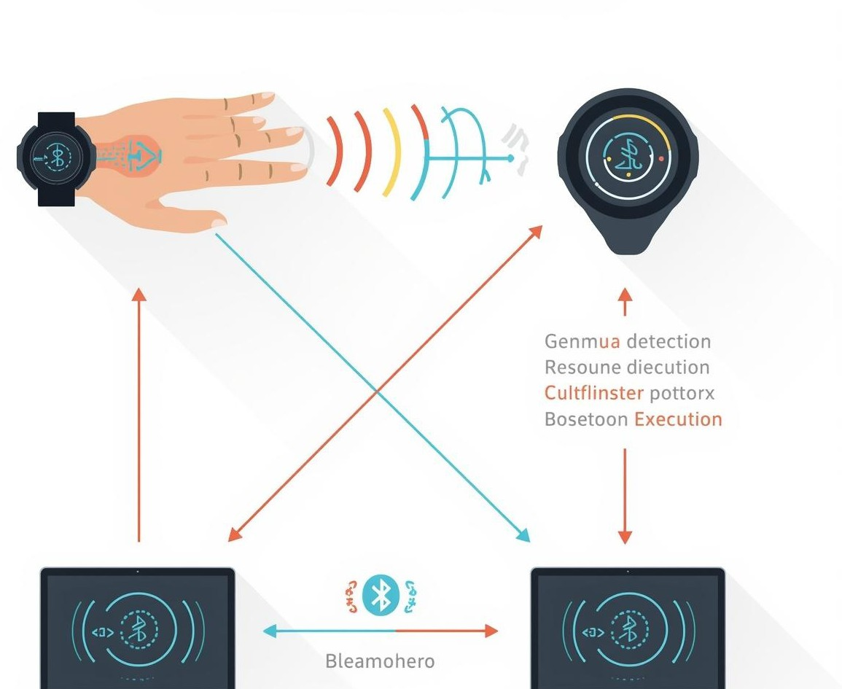
System Workflow
The system detects hand gestures through sensors, sending processed data via Bluetooth to the laptop, which executes commands based on user-defined mappings, enhancing intuitive control without physical interaction.
ser performs hand gestures which are detected by sensors
Microcontroller processes the sensor data and sends it via Bluetooth
Laptop receives the gesture data and performs the required action

Slide 5
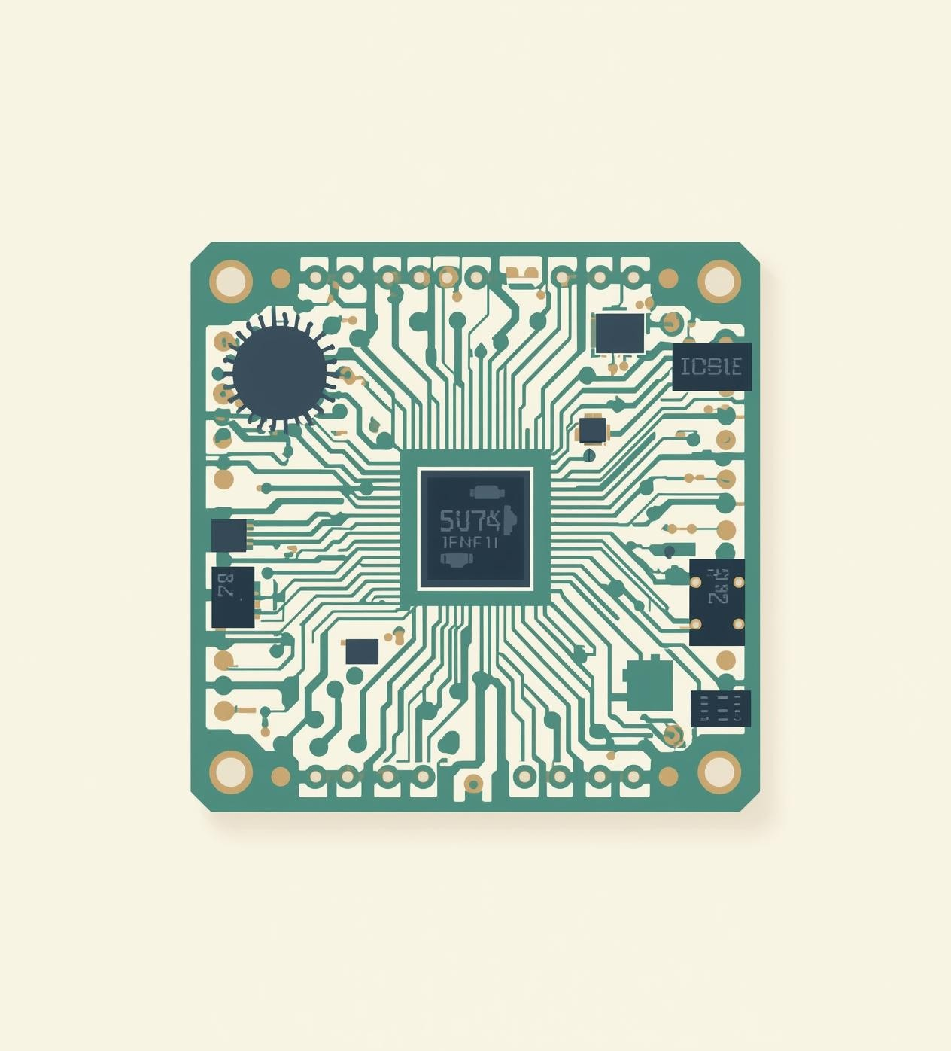
PRE Existing technologies
Overview of Gesture and Interface Systems
Vision-Based Gesture System:-
Utilizes cameras and image processing technology
Provides high accuracy, but can be affected by lighting conditions Demands considerable computational resources
Sensor-Based Wearable Systems
Incorporates accelerometers and gyroscopes
Operates independently of lighting and background influences Lightweight design, making it perfect for real-time control
Touch & Voice-Based Interfaces
Includes touchpads and voice recognition assistants
Limited performance in noisy settings or when hands are occupied Less accommodating for individuals with physical disabilities
Limitations of Current Systems
Often expensive or require complicated setups Lack portability and flexibility
Not entirely suited for all user scenarios.

Slide 6
TECH STACK
Hardware Layer (Wearable Device)
ESP32 Control Unit
MPU6050 / MPU9250 IMU Sensor Module On-board BLE Transmitter
Wearable Glove / Strap Platform Lithium-ion Power Module
Firmware Layer (Embedded Programming)
Arduino C / ESP-IDF (for ESP32) Firmware Gesture Encoder
Sensor Fusion Algorithms (Complementary Filter / Kalman Filter)
BLE Data Packet Transmission Layer Gesture Opcode Generator
Communication Layer
Bluetooth Low Energy (BLE)
Low-Latency Device-to-Host Data Channel Custom Gesture Data Packet (GDP) Protocol Host-Side Command Listener (Python)
Software Layer (Laptop / Application Side)
Language:
Python
Core Libraries:
pyserial / bleak – BLE communication numpy – sensor data handling
scikit-learn (optional) – gesture classification ML pyautogui – laptop input automation
pynput – mouse/keyboard control matplotlib – gesture debugging (optional) Modules:
Host-Side Gesture Processing Engine Gesture Decoding Module
Action Mapping Layer (AML) Virtual Input Controller Purpose:
Receives BLE packets → decodes gesture → executes laptop actions.
System Integration Layer
Motion-to-Action Pipeline (MAP)
Laptop Control Abstraction Layer (LCAL)
Real-time Human-Computer Interaction Layer (HCI Layer)
Tools & Platforms
Arduino IDE / PlatformIO – ESP32 programming VS Code – Application development
Jupyter Notebook (optional) – ML model training Git/GitHub – version control
Figma / Canva – UI & diagrams

Slide 7
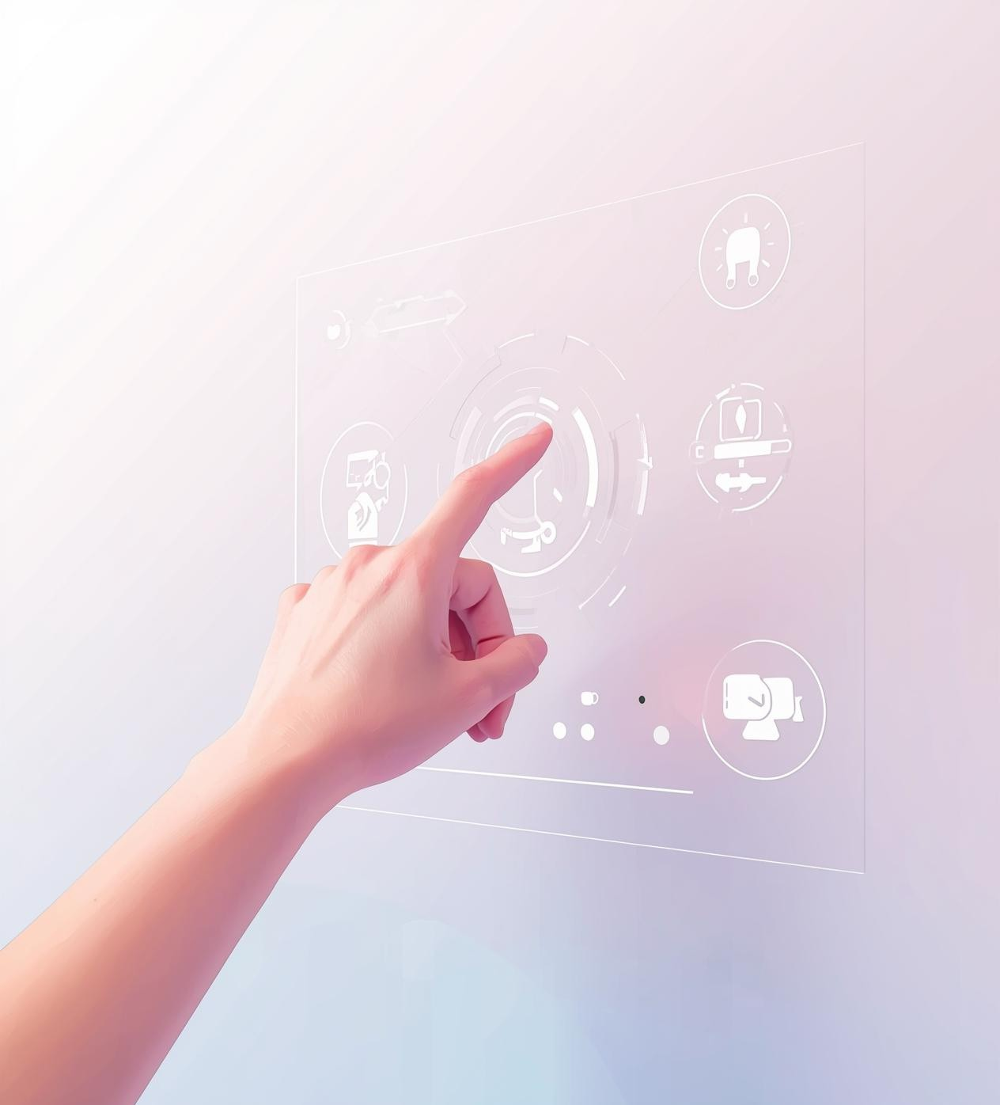
Societal Impact and Applications
Assistive technology for physically challenged users
Touchless control in healthcare environments Smart classrooms & presentations
Virtual Reality (VR) and Gaming Industrial automation control
Benefits to Society
Improves digital accessibility
Reduces dependency on physical devices Promotes inclusive technology
Enhances productivity and comfort

Slide 8
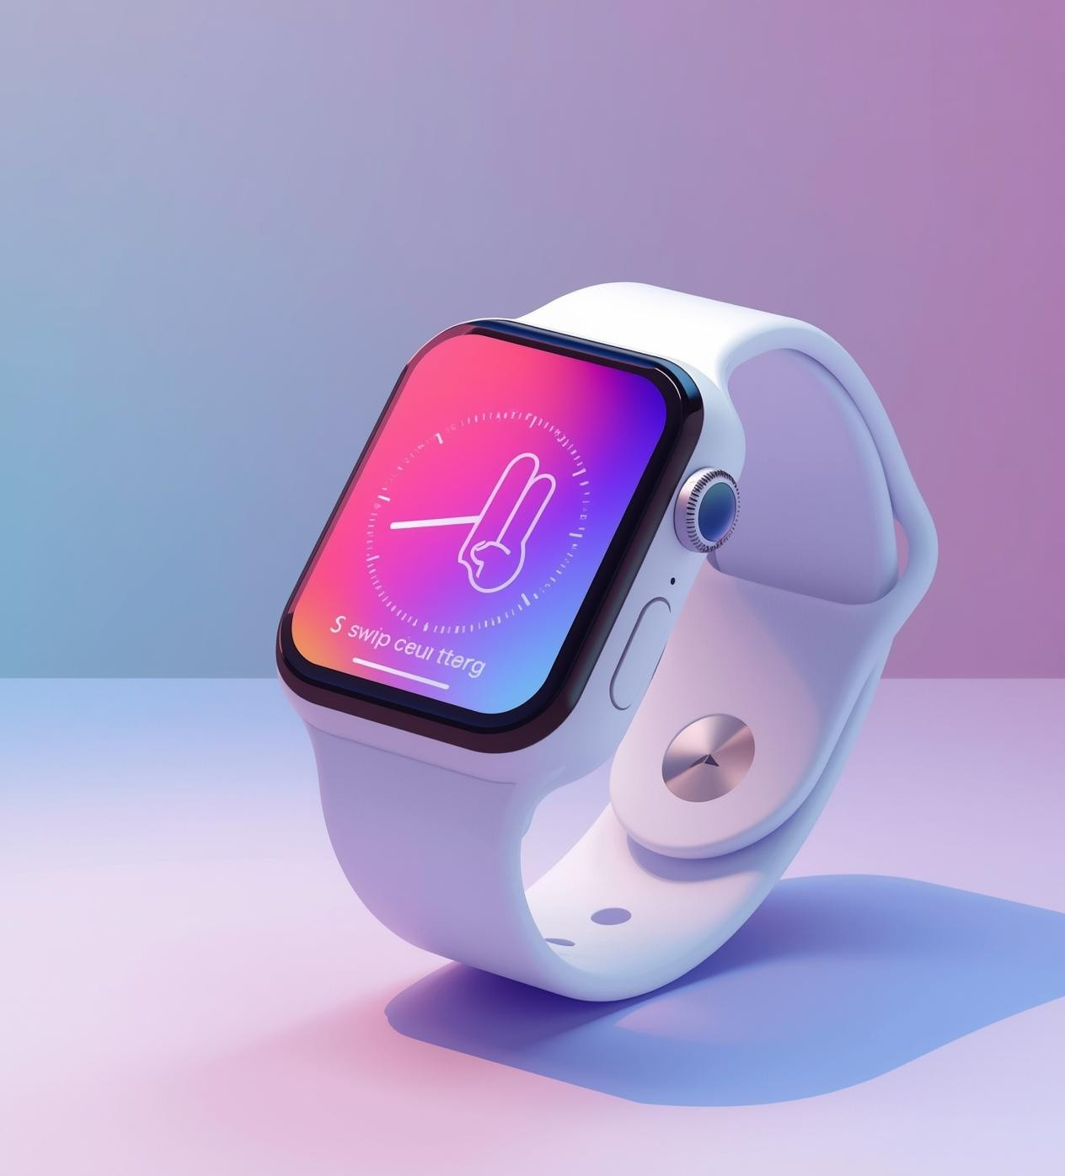
Novelty and Uniqueness
Interaction through wearable devices rather than relying on camera-based systems
A portable and user-specific control mechanism
A low-power, cost-effective solution Customizable gestures tailored for different users
Real-time recognition of gestures Distinctive features
Independence from external cameras Functionality in low-light environments Personalized mapping of gestures

Slide 9
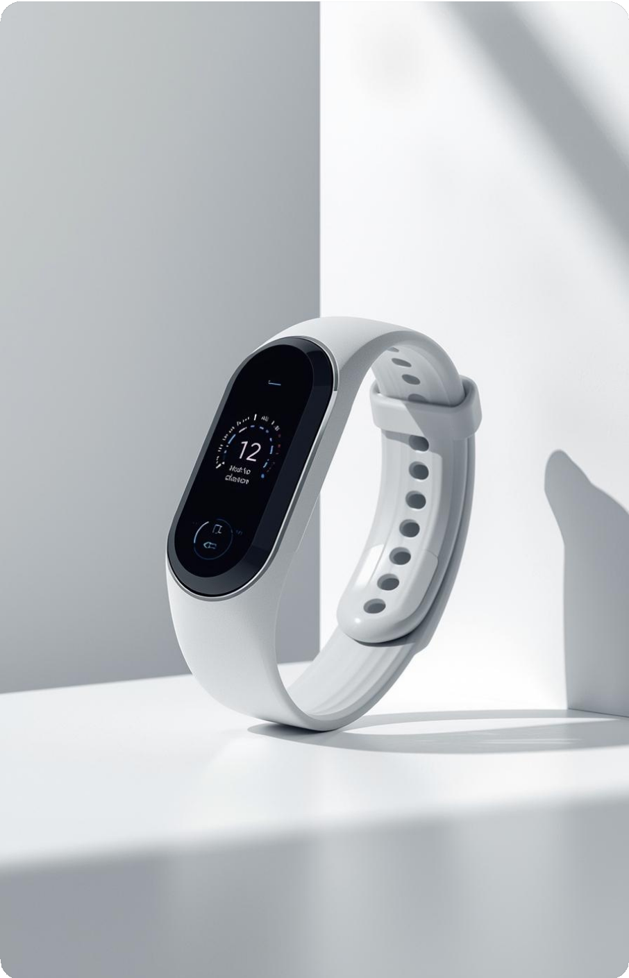

Conclusion
The project offers a smart and easy way to control a laptop using simple gestures. It shows strong use of wearable sensors, improves the way people interact with computers, and sets the stage for future upgrades like AI‑driven learning, richer gesture sets, smart home links, mobile control, and better accuracy.

Slide 10
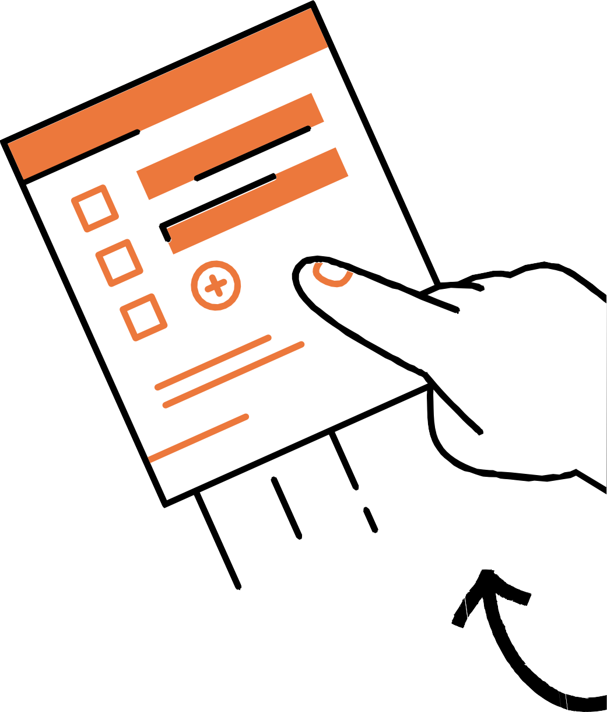
Thank
You

